Slide 1
Wireless Communication
Compiled by :- Asst. Prof. Rashmi Pote

Slide 2
Wireless Communications
  Bluetooth
  Wi-Fi
  Mobile Communications
  LTE
  LTE-Advanced
  5G Technology

Slide 3
BLUETOOTH

Slide 4
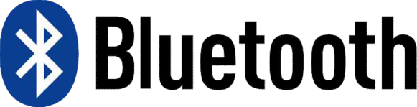

Bluetooth
Bluetooth
Bluetooth is a WPAN (Wireless Personal Area Network) communications protocol designed by the Bluetooth SIG (Special Interest Group)
Replaces cables connecting many different types of devices
  Mobile Phones & Headsets
  Heart Monitors & Medical Equipment

Slide 5
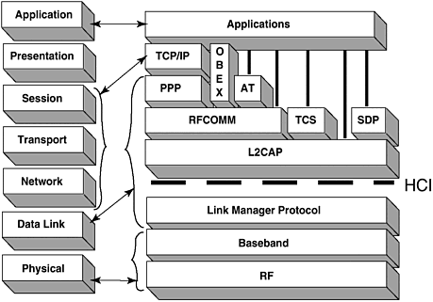
Bluetooth Protocol Stack
Notes:
Image source:
http://flylib.com/books/en/4.215.1.116/1/
Explanation: from Wikipedia
Bluetooth protocol stack[edit]
Main articles: Bluetooth stack and Bluetooth protocols
Bluetooth Protocol Stack
Bluetooth is defined as a layer protocol architecture consisting of core protocols, cable replacement protocols, telephony control protocols, and adopted protocols.^{[78]} Mandatory protocols for all Bluetooth stacks are: LMP, L2CAP and SDP. In addition, devices that communicate with Bluetooth almost universally can use these protocols: HCI and RFCOMM.^{[citation needed]}
LMP[edit]
The Link Management Protocol (LMP) is used for set-up and control of the radio link between two devices. Implemented on the controller.
L2CAP[edit]
The Logical Link Control and Adaptation Protocol (L2CAP) is used to multiplex multiple logical connections between two devices using different higher level protocols. Provides segmentation and reassembly of on-air packets.
In Basic mode, L2CAP provides packets with a payload configurable up to 64 kB, with 672 bytes as the default MTU, and 48 bytes as the minimum mandatory supported MTU.
In Retransmission and Flow Control modes, L2CAP can be configured either for isochronous data or reliable data per channel by performing retransmissions and CRC checks.
Bluetooth Core Specification Addendum 1 adds two additional L2CAP modes to the core specification. These modes effectively deprecate original Retransmission and Flow Control modes:
Enhanced Retransmission Mode (ERTM): This mode is an improved version of the original retransmission mode. This mode provides a reliable L2CAP channel.
Streaming Mode (SM): This is a very simple mode, with no retransmission or flow control. This mode provides an unreliable L2CAP channel.
Reliability in any of these modes is optionally and/or additionally guaranteed by the lower layer Bluetooth BDR/EDR air interface by configuring the number of retransmissions and flush timeout (time after which the radio flushes packets). In-order sequencing is guaranteed by the lower layer.
Only L2CAP channels configured in ERTM or SM may be operated over AMP logical links.
SDP[edit]
The Service Discovery Protocol (SDP) allows a device to discover services offered by other devices, and their associated parameters. For example, when you use a mobile phone with a Bluetooth headset, the phone uses SDP to determine which Bluetooth profiles the headset can use (Headset Profile, Hands Free Profile, Advanced Audio Distribution Profile (A2DP) etc.) and the protocol multiplexer settings needed for the phone to connect to the headset using each of them. Each service is identified by a Universally Unique Identifier (UUID), with official services (Bluetooth profiles) assigned a short form UUID (16 bits rather than the full 128).
RFCOMM[edit]
Radio Frequency Communications (RFCOMM) is a cable replacement protocol used to generate a virtual serial data stream. RFCOMM provides for binary data transport and emulates EIA-232(formerly RS-232) control signals over the Bluetooth baseband layer, i.e. it is a serial port emulation.
RFCOMM provides a simple reliable data stream to the user, similar to TCP. It is used directly by many telephony related profiles as a carrier for AT commands, as well as being a transport layer for OBEX over Bluetooth.
Many Bluetooth applications use RFCOMM because of its widespread support and publicly available API on most operating systems. Additionally, applications that used a serial port to communicate can be quickly ported to use RFCOMM.
BNEP[edit]
The Bluetooth Network Encapsulation Protocol (BNEP) is used for transferring another protocol stack's data via an L2CAP channel. Its main purpose is the transmission of IP packets in the Personal Area Networking Profile. BNEP performs a similar function to SNAP in Wireless LAN.
AVCTP[edit]
The Audio/Video Control Transport Protocol (AVCTP) is used by the remote control profile to transfer AV/C commands over an L2CAP channel. The music control buttons on a stereo headset use this protocol to control the music player.
AVDTP[edit]
The Audio/Video Distribution Transport Protocol (AVDTP) is used by the advanced audio distribution profile to stream music to stereo headsets over an L2CAP channel intended for video distribution profile in the Bluetooth transmission.
TCS[edit]
The Telephony Control Protocol – Binary (TCS BIN) is the bit-oriented protocol that defines the call control signaling for the establishment of voice and data calls between Bluetooth devices. Additionally, "TCS BIN defines mobility management procedures for handling groups of Bluetooth TCS devices."
TCS-BIN is only used by the cordless telephony profile, which failed to attract implementers. As such it is only of historical interest.
Adopted protocols[edit]
Adopted protocols are defined by other standards-making organizations and incorporated into Bluetooth’s protocol stack, allowing Bluetooth to code protocols only when necessary. The adopted protocols include:
Point-to-Point Protocol (PPP): Internet standard protocol for transporting IP datagrams over a point-to-point link.
TCP/IP/UDP: Foundation Protocols for TCP/IP protocol suite
Object Exchange Protocol (OBEX): Session-layer protocol for the exchange of objects, providing a model for object and operation representation
Wireless Application Environment/Wireless Application Protocol (WAE/WAP): WAE specifies an application framework for wireless devices and WAP is an open standard to provide mobile users access to telephony and information services.^{[78]}
Baseband error correction[edit]
Depending on packet type, individual packets may be protected by error correction, either 1/3 rate forward error correction (FEC) or 2/3 rate. In addition, packets with CRC will be retransmitted until acknowledged by automatic repeat request (ARQ).
Setting up connections[edit]
Any Bluetooth device in discoverable mode transmits the following information on demand:
Device name
Device class
List of services
Technical information (for example: device features, manufacturer, Bluetooth specification used, clock offset)
Any device may perform an inquiry to find other devices to connect to, and any device can be configured to respond to such inquiries. However, if the device trying to connect knows the address of the device, it always responds to direct connection requests and transmits the information shown in the list above if requested. Use of a device's services may require pairing or acceptance by its owner, but the connection itself can be initiated by any device and held until it goes out of range. Some devices can be connected to only one device at a time, and connecting to them prevents them from connecting to other devices and appearing in inquiries until they disconnect from the other device.
Every device has a unique 48-bit address. However, these addresses are generally not shown in inquiries. Instead, friendly Bluetooth names are used, which can be set by the user. This name appears when another user scans for devices and in lists of paired devices.
Most cellular phones have the Bluetooth name set to the manufacturer and model of the phone by default. Most cellular phones and laptops show only the Bluetooth names and special programs are required to get additional information about remote devices. This can be confusing as, for example, there could be several cellular phones in range named T610 (see Bluejacking).

Slide 6
Bluetooth
Bluetooth Protocol Stack
  LMP: Link Management Protocol
    Set-up and control of the link between two devices
  L2CAP: Logical Link Control and Adaptation Protocol
    Multiplex multiple logical connections between two devices
    Segmentation and reassembly
    Payload
      Default MTU: 672 bytes
      Max: Up to 62KB
      Min: 48 bytes
    Retransmission and CRC check

Slide 7
Bluetooth
Bluetooth Protocol Stack
  SDP: Service Discovery Protocol
    To determine which Bluetooth profiles can be used (ex) A2DP, …
Notes:
RFCOMM: Radio Frequency Communications
A cable replacement protocol
To provide for binary data transport
TCS: Telephony Control Protocol
OBEX: Object Exchange Protocol

Slide 8
Bluetooth
A2DP (Advanced Audio Distribution Profile)
A2DP enables wireless transmission of stereo audio from an A2DP smartphone (or computer) to A2DP headphones (or stereo system)

Slide 9
Bluetooth
aptX
Supports wireless real-time streaming of high-quality stereo audio over the Bluetooth A2DP
Includes proprietary audio codec compression algorithms
Used in various consumer and automotive wireless audio applications

Slide 10
Bluetooth
Enhanced Data Rate (EDR)
Introduced in Bluetooth v2.0 to support faster data transfer
Supports a data rate up to 3 Mbps
Using reduced duty cycle control, EDR can provide lower power consumption

Slide 11
Bluetooth
Bluetooth High Speed (HS)
Bluetooth high speed technology was released in April 2009 (in Bluetooth version 3.0+HS)
Bluetooth 3.0+HS provides data transfer speeds of up to 24 Mbps, though not over the Bluetooth link itself
Bluetooth link is used for negotiation and establishment, and the high data rate traffic is carried over a collocated 802.11 link

Slide 12
Bluetooth
Bluetooth High Speed (HS)
• +HS part of the specification is not mandatory in Bluetooth version 3.0
Only devices that display the "+HS" logo support Bluetooth over 802.11 high-speed data transfer

Slide 13
Bluetooth
Bluetooth 4.0
Bluetooth Specification 4.0 (called Bluetooth Smart) was adopted in June 2010
Bluetooth 4.0 includes
  Former Bluetooth standards
  BLE (Bluetooth Low Energy)

Slide 14
BLE (Bluetooth Low Energy)
Provide reduced power consumption and cost while maintaining a similar communication range
  1–2 years with a 1,000mAh coin cell battery
  Smart protocol which only transmits small packets as compared to Bluetooth Classic
  depending on type of scans and number of Bluetooth Smart devices in the vicinity
  Defines several profiles (specifications) on how a device can consume very low energy consumption while servicing a particular application
Notes:
https://en.wikipedia.org/wiki/Bluetooth_low_energy
A study by beacon software company, Aislelabs, reported that peripherals, such as proximity beacons, usually function for 1–2 years with a 1,000mAh coin cell battery.^{[37]} This is possible because of power efficiency of Bluetooth Smart protocol which only transmits small packets as compared to Bluetooth Classic which is also suitable for audio and high bandwidth data.
In contrast, a continuous scan for the same beacons in central role can consume 1,000 mAh in a few hours. Android and iOS devices also have very different battery impact depending on type of scans and number of Bluetooth Smart devices in the vicinity.^{[38]} With the newer chipsets and advances in software, both Android and iOS phones now have negligible power consumption in real-life Bluetooth Smart use scenarios.^{[39]}
GATT: Generic Attribute Profile
Finally, GATT offers notifications and indications. The client may request a notification for a particular characteristic from the server. The server can then send the value to the client whenever it becomes available. For instance, a temperature sensor server may notify its client every time it takes a measurement. This avoids the need for the client to poll the server, which would require the server's radio circuitry to be constantly operational.
An indication is similar to a notification, except that it requires a response from the client, as confirmation that it has received the message.

Slide 15
Bluetooth
BLE (Bluetooth Low Energy)
A manufacturer can implement customize specifications for their product
A device can have multiple BLE profiles
  Health Care Profiles
  Sports and fitness profiles
  IPSP (Internet Protocol Support Profile)
  ESP (Environmental Sensing Profile)
  etc.
Notes:
Bluetooth Low Energy
https://en.wikipedia.org/wiki/Bluetooth_low_energy
Applications[edit]
Health care profiles[edit]
There are many profiles for Bluetooth Smart devices in healthcare applications. The Continua Health Alliance consortium promotes these in cooperation with the Bluetooth SIG.
BLP (Blood Pressure Profile) — for blood pressure measurement.
HTP (Health Thermometer Profile) — for medical temperature measurement devices.
GLP (Glucose Profile) — for blood glucose monitors.
CGMP (Continuous Glucose Monitor Profile)
Sports and fitness profiles[edit]
Profiles for sporting and fitness accessories include:
BCS (Body Composition Service)
CSCP (Cycling Speed and Cadence Profile) — for sensors attached to a bicycle or exercise bike to measure cadence and wheel speed.
CPP (Cycling Power Profile)
HRP (Heart Rate Profile) — for devices which measure heart rate
LNP (Location and Navigation Profile)
RSCP (Running Speed and Cadence Profile)
WSP (Weight Scale Profile)
Internet Connectivity[edit]
IPSP (Internet Protocol Support Profile)
Generic Sensors[edit]
ESP (Environmental Sensing Profile)
UDS (User Data Service)
HID Connectivity[edit]
HOGP (HID over GATT Profile)...
Proximity sensing[edit]
"Electronic leash" applications are well suited to the long battery life possible for 'always-on' devices.^{[22]} Manufacturers of iBeacon devices implement the appropriate specifications for their device to make use of proximity sensing capabilities supported by Apple Inc. compatible iDevices.^{[23]}
Relevant application profiles include:
FMP — the "find me" profile — allows one device to issue an alert on a second misplaced device.^{[24]}
PXP — the proximity profile — allows a proximity monitor to detect whether a proximity reporter is within a close range. Physical proximity can be estimated using the radio receiver's RSSIvalue, although this does not have absolute calibration of distances. Typically, an alarm may be sounded when the distance between the devices exceeds a set threshold.
Alerts and time profiles[edit]
The phone alert status profile and alert notification profile allow a client device to receive notifications such as incoming call alerts from another device.
The time profile allows current time and time zone information on a client device to be set from a server device, such as between a wristwatch and a mobile phone's network time.
Battery[edit]
The Battery Service exposes the Battery State and Battery Level of a single battery or set of batteries in a device.

Slide 16
Bluetooth low energy or Bluetooth smart is a short range communication protocol with PHY and MAC layer widely used for in-vehicle networking.
Its low energy can reach ten times less than the classic Bluetooth while its latency can reach 15 times.
Its access control uses a contention-less MAC with low latency and fast transmission. It follows master/slave architecture and offers two types of frames: adverting and data frames.
The Advertising frame is used for discovery and is sent by slaves on one or more of dedicated advertisement channels.
Master nodes sense advertisement channels to find slaves and connect them. After connection, the master tells the slave its waking cycle and scheduling sequence.
Nodes are usually awake only when they are communicating and they go to sleep otherwise to save their power

Slide 17
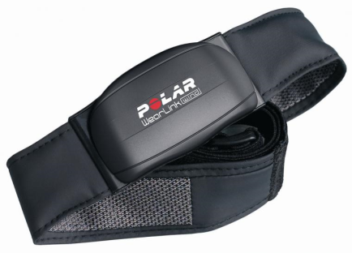
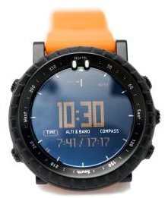
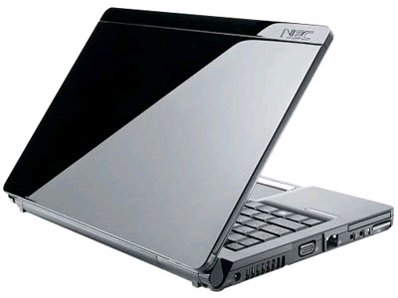

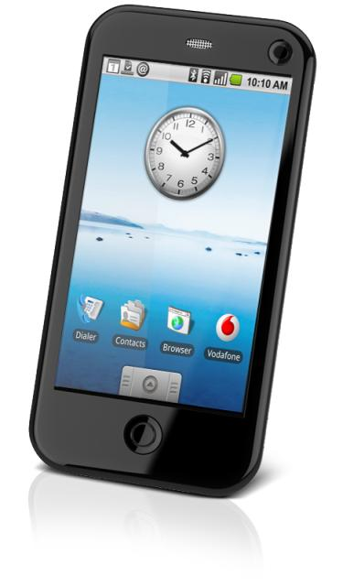
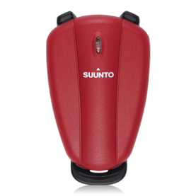
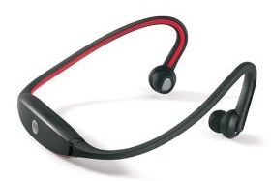
BLE in Watches and Displays
  A new ecosystem of connectivity

Slide 18
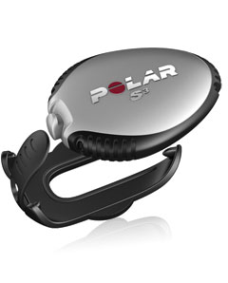
BLE in Sports and Fitness Products
Direct to phone, PC or music player options
  Training upload and web service integration
  Advanced mapping

Slide 19
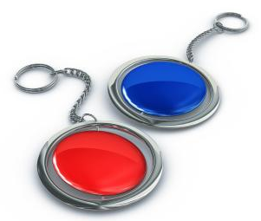
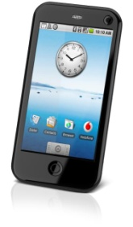

BLE in Proximity and Access
Bluetooth low energy low cost tags that last for many years on a coin cell
Proximity – Two devices alarm when moved out of signal range
  e.g. Key fob alerts when mobile phone out of range
Access – Tablet logs you in when key fob is detected
Personalization – Car adjusts seat to favorite position when you get in

Slide 20
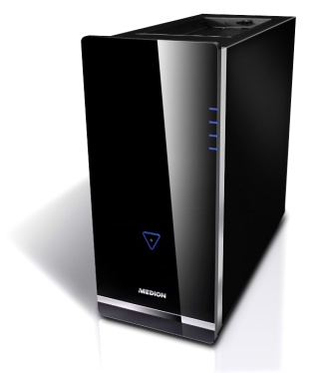
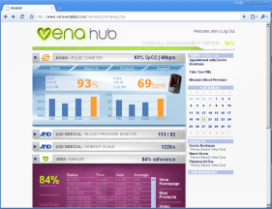
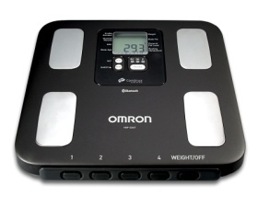
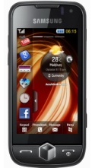


Example of Service
Bluetooth HDP profile
Internet Protocol
Internet Protocol
Health device
Mobile Handset
Health Service
Medical records server
Health management
Coaching
Healthcare integration

Slide 21
Applications of BLE
  Health care profiles
  BLP (Blood Pressure Profile) — for blood pressure measurement.
  HTP (Health Thermometer Profile) — for medical temperature measurement devices.
  GLP (Glucose Profile) — for blood glucose monitors.
  CGMP (Continuous Glucose Monitor Profile)
  Internet Connectivity
  IPSP (Internet Protocol Support Profile)
  Generic Sensors
  ESP (Environmental Sensing Profile)
  UDS (User Data Service)
  HID Connectivity
  HOGP (HID over GATT Profile)...
  Sports and fitness profiles
  Profiles for sporting and fitness accessories include:
  BCS (Body Composition Service)
  CSCP (Cycling Speed and Cadence Profile) — for sensors attached to a bicycle or exercise bike to measure cadence and wheel speed.
  CPP (Cycling Power Profile)
  HRP (Heart Rate Profile) — for devices which measure heart rate
  LNP (Location and Navigation Profile)
  RSCP (Running Speed and Cadence Profile)
  WSP (Weight Scale Profile)
Notes:
HID: Human Interface Device
GATT: Generic Attribute Profile
https://en.wikipedia.org/wiki/Bluetooth_low_energy
Software model[edit]
All Bluetooth Smart devices use the Generic Attribute Profile (GATT). The application programming interface offered by a Bluetooth Smart aware operating system will typically be based around GATT concepts.^{[34]} GATT has the following terminology:
ClientA device that initiates GATT commands and requests, and accepts responses, for example, a computer or smartphone.ServerA device that receives GATT commands and requests, and returns responses, for example, a temperature sensor.CharacteristicA data value transferred between client and server, for example, the current battery voltage.ServiceA collection of related characteristics, which operate together to perform a particular function. For instance, the Health Thermometer service includes characteristics for a temperature measurement value, and a time interval between measurements.DescriptorA descriptor provides additional information about a characteristic. For instance, a temperature value characteristic may have an indication of its units (e.g. Celsius), and the maximum and minimum values which the sensor can measure. Descriptors are optional - each characteristic can have any number of descriptors.Some service and characteristic values are used for administrative purposes - for instance, the model name and serial number can be read as standard characteristics within the Generic Accessservice. Services may also include other services as sub-functions; the main functions of the device are so-called primary services, and the auxiliary functions they refer to are secondaryservices.
Identifiers[edit]
Services, characteristics, and descriptors are collectively referred to as attributes, and identified by UUIDs. Any implementer may pick a random or pseudorandom UUID for proprietary uses, but the Bluetooth SIG have reserved a range of UUIDs (of the form xxxxxxxx-0000-1000-8000-00805F9B34FB ^{[35]}) for standard attributes. For efficiency, these identifiers are represented as 16-bit or 32-bit values in the protocol, rather than the 128 bits required for a full UUID. For example, the Device Information service has the short code 0x180A, rather than 0000180A-0000-1000-... . The full list is kept in the Bluetooth Assigned Numbers document online.
GATT Operations[edit]
The GATT protocol provides a number of commands for the client to discover information about the server. These include:
Discover UUIDs for all primary services
Find a service with a given UUID
Find secondary services for a given primary service
Discover all characteristics for a given service
Find characteristics matching a given UUID
Read all descriptors for a particular characteristic
Commands are also provided to read (data transfer from server to client) and write (from client to server) the values of characteristics:
A value may be read either by specifying the characteristic's UUID, or by a handle value (which is returned by the information discovery commands above).
Write operations always identify the characteristic by handle, but have a choice of whether or not a response from the server is required.
'Long read' and 'Long write' operations can be used when the length of the characteristic's data exceeds the MTU of the radio link.
Finally, GATT offers notifications and indications. The client may request a notification for a particular characteristic from the server. The server can then send the value to the client whenever it becomes available. For instance, a temperature sensor server may notify its client every time it takes a measurement. This avoids the need for the client to poll the server, which would require the server's radio circuitry to be constantly operational.
An indication is similar to a notification, except that it requires a response from the client, as confirmation that it has received the message.

Slide 22
LET’S WATCH A VIDEO
What is BLE? (2020) | Bluetooth Low Energy |
Learn Technology in 5 Minutes
https://www.youtube.com/watch?v=NSkIHdV6NoY

Slide 23
Question Please

